Slide 1
The politics of sustaining Zambia’s social cash transfer program
Hangala Siachiwena
Centre for social science research monthly webinar
15 December 2020

Slide 2
Focus of presentation
The ruling Patriotic Front (PF) government is implementing a national social cash transfer programme but has effectively suspended payments to beneficiaries of the programme.
What explains the government’s notional support to the programme while supporting other forms of redistribution in practice?

Slide 3
background
Introduction of pilot SCT program in 2003
MMD govt. resisted donor efforts to expand pilots into national programs from 2000 to 2011
Lack of political will/lack of institutional capacity (Barrientos et al., 2005)
Neoliberal ideology: consumption vs growth (Habasonda, 2009)
Enduring patrimonial system: clientelist vs programmatic distribution (Harland, 2014)
Influence of Finance Minister, Ng’andu Magande (Kabandula & Seekings, 2016)
Expansion of social protection and SCT after election of President Michael Sata in 2011

Slide 4

Social protection reforms 2011-2014
Expansion of SCT coverage 2013/14
Introduction of National Social Protection Policy (2014)
Govt. assumes primary funding from donors for SCTs (2014)
Shift from clientelist to programmatic redistribution

Slide 5
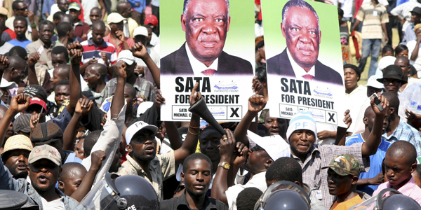
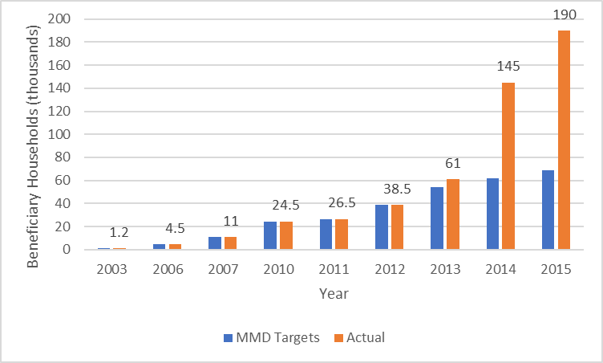
Expansion of social cash transfer program under president sata, 2011-14

Slide 6
Factors explaining social protection reforms under president sata
Convergence between donor ideas about the role of cash transfers in development and the PF’s support for a ‘leftist’ pro-poor development agenda.
Interests of political elites in Sata’s administration
Ideas, beliefs and attitudes about development (and poverty reduction)
Electoral competition (branding around agriculture subsidies and alternative programmes)
Factionalism (contestation for power within PF between pro-poor faction and pro-business faction)

Slide 7

Social protection reform under president lungu 2015-2020
Edgar Lungu elected in January 2015 presidential by-election replacing Sata who died in office
The PF government has committed to expanding the SCT program but what has been achieved in practice falls far below set targets
What explains PF’s notional commitment to expanding cash transfers despite emphasis on other forms of redistribution?

Slide 8
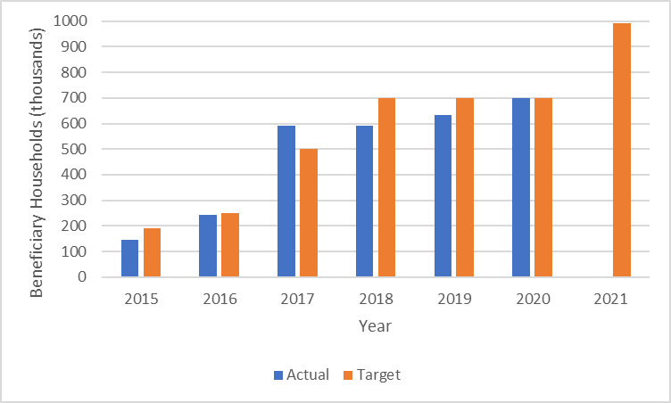
Coverage of social cash transfers
Year | Target Households | Actual Beneficiary Households
2015 | 190,000 | 145,000
2016 | 250,000 | 242,000
2017 | 500,000 | 590,000
2018 | 700,000 | 590,000
2019 | 700,000 | 632,000
2020 | 700,000 | 700,000
2021 | 994,000

Slide 9
Sct budget and spending
Year | Total SCT Budget (Kwacha millions) | GRZ Budget (Kwacha millions) | GRZ Spent (Kwacha millions)
2016 | 331 | 250 | 119
2017 | 737 | 500 | 353
2018 | 980 | 500 | 317
2019 | 1000 | 699 | 93

Slide 10
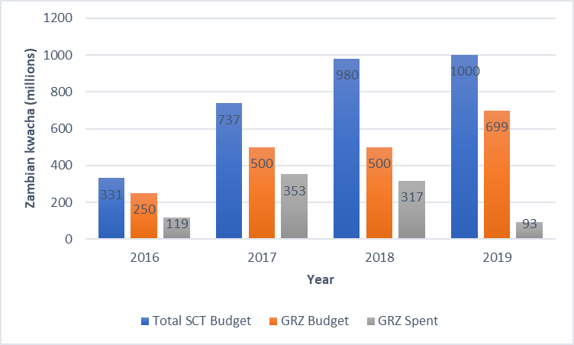
Clientelist vs programmatic redistribution
Delayed payments to SCT beneficiaries, at least since 2015
Public scandal: US$ 4.3 million donor funds for SCT beneficiaries went ‘missing’ in 2018
Introduction of empowerment schemes: Presidential Empowerment Initiative Fund (2015) and Multi-sectoral Youth Empowerment scheme (2020)
Expansion of farmer input support program (FISP)
Politicization of cash transfers

Slide 11
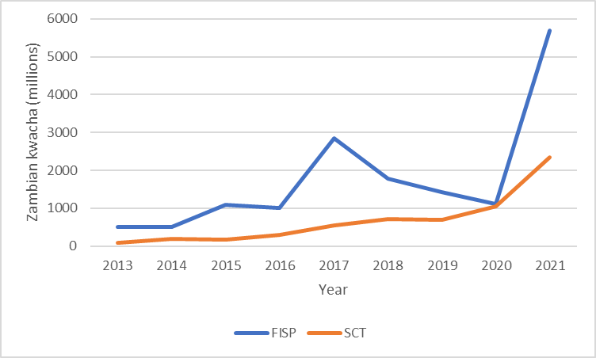
Fisp and sct budget allocations, 2013-2021

Slide 12
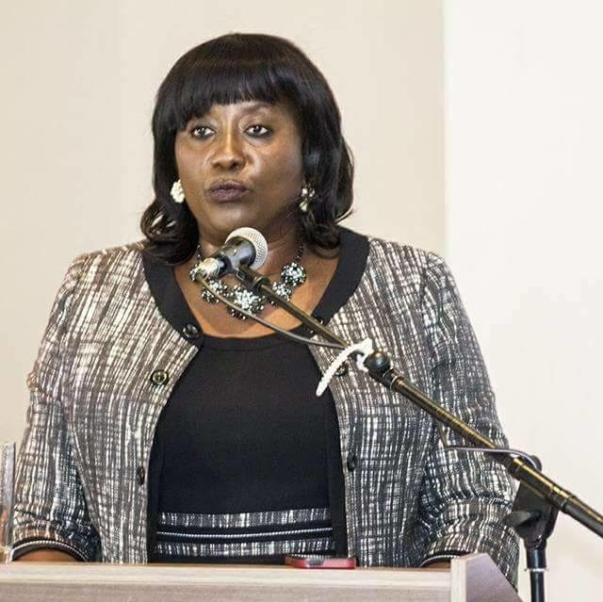
Politicization of cash transfers
“President Lungu has worked. He gave you money for the poor here in Samfya [district] and the social cash transfer programme has reached 17,000 people. And for the women, I already bought you phones for 2000 of you and you are already getting paid K1,000 each. Do you think anyone else will come and give you money the way President Lungu is giving you? There will be no one…Social cash transfer will reach more people so that it covers 23,000 people. That is how much President Lungu loves you.”
Emerine Kabanshi, Minister of Community Development and Social Services (2014-2018)

Slide 13
Explaining reforms under lungu
What explains the notional commitment to cash transfers under the Lungu administration despite preference for clientelist redistribution?
Influence of coalition of donors and government technocrats (especially Ministry of Community Development and Social Services)
Donors initiated Covid Emergency Cash Transfer in June 2020 targeting 258,000 households
Commitment to pro-poor agenda
The 2021 elections and ‘empowerment patronage’
Fiscal capacity (economic conditions)

Slide 14
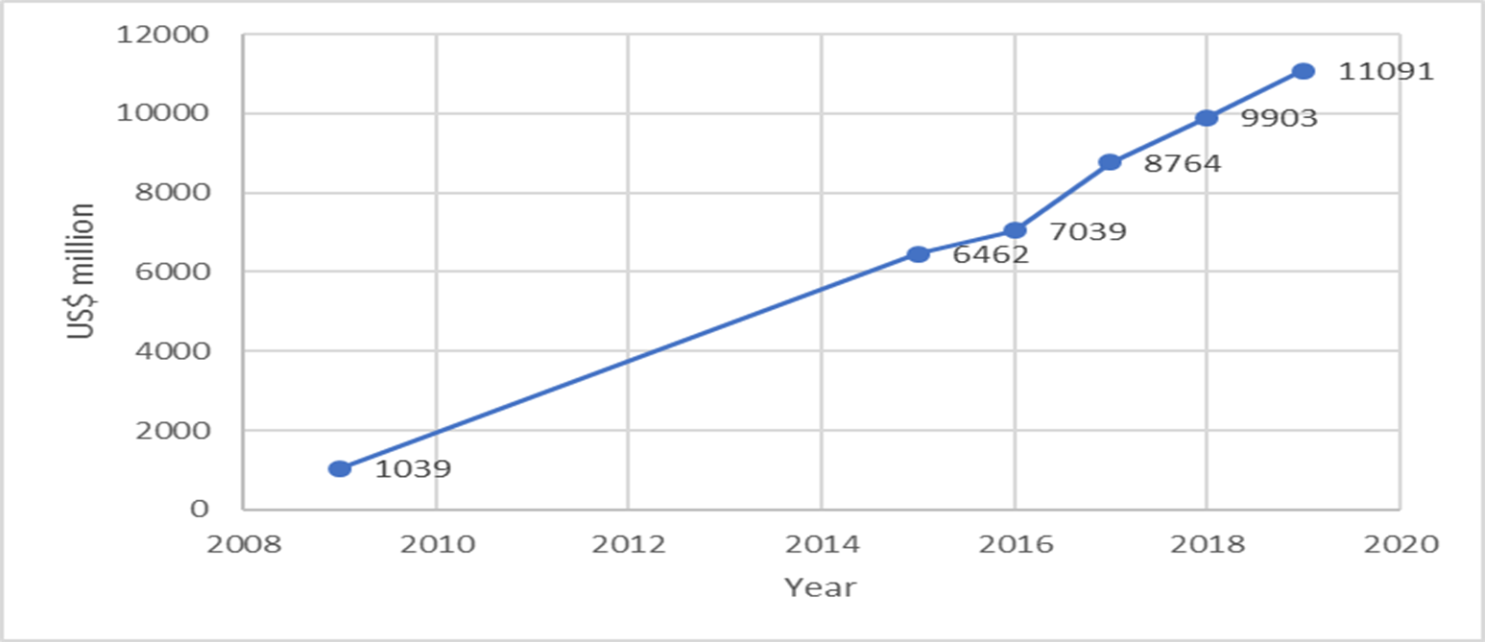
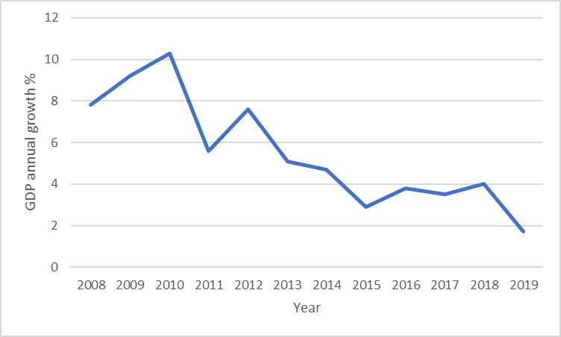
Economic conditions: debt and growth

Slide 15
conclusion
(I) There appears to be a mismatch between the ideas of international donors regarding the role of cash transfers in alleviating poverty, and the ideas that political elites in the ruling party have about development broadly and the role of cash transfers in poverty reduction.
Adesina, J (2020). Policy Merchandising and Social Assistance in Africa: Don’t Call Dog Monkey for Me. Development and Change 51(2): 561-582
(II) Domestic political factors help to explain policy reforms to expand cash transfers in the 2010s (a change of government in 2011) but different domestic political factors (sustaining power) help to explain the ruling party’s decision to effectively suspend cash transfer payments.

Slide 16
conclusion
(III) Zambian voters (citizens) do not consider cash transfers to be effective for poverty reduction – and thus not consequential to inform voting behaviour?

Slide 17
Thanks!
Hangala.Siachiwena@uct.ac.za

